Slide 1
GEOG0125
Advanced Topics in Social and Geographic Data Science
Introduction to BAYESIAN GeneraliSed ADDITIVE modelS (GAM)
Dr Anwar Musah (a.musah@ucl.ac.uk)
Lecturer in Social and Geographic Data Science
UCL Geography
1

Slide 2
Contents
Problem
What are Generalised Additive Models (GAMs)?
Usage: For exploring non-linear relationships
Importance: Notable applications in assessing or generating a so called “dose-response curve”
Trades-off in Model Building: Linear vs. Machine Learning
Model components of GAMs
Polynomials
Basis functions & Smoothing
Example and interpretation
Model Specification from a Bayesian Framework
RStudio
The package for implementing GAMs is called Bayesian Regression Models in Stan (BRMS).
Uses the brm() and brm::stancode() (translates the RStudio code directly into Stan code – incredibly useful)
Knowledge
Collect
Model
Wrangle
Explore
2

Slide 3
Remember in Week 2’s we covered…
3

Slide 4
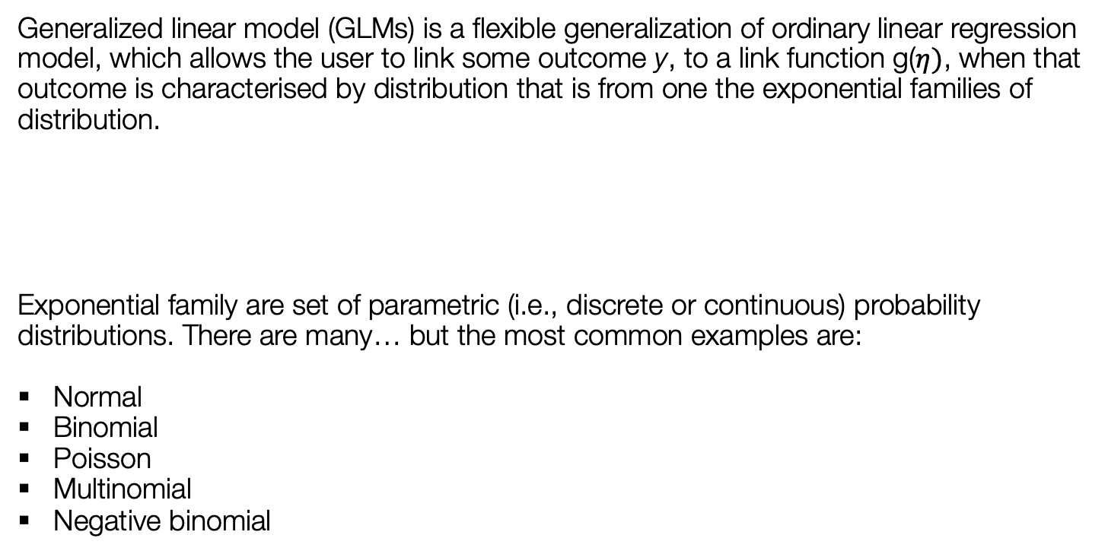
Recap on Definition:
Generalized linear model (GLMs) is a flexible generalization of ordinary linear regression model, which allows the user to link some outcome y, to a link function g($η)$, when that outcome is characterised by distribution that is from one the exponential families of distribution.
Exponential family are set of parametric (i.e., discrete or continuous) probability distributions. There are many… but the most common examples are:
Normal
Binomial
Poisson
Multinomial
Negative binomial
$$g(η)= β_{0}+β_{1}x_{1}+β_{2}x_{2}+…+ε$$
Notes 1: There are a tonne of them, but you really don’t have to worry about any of them. You only need to concern yourself with how this link function works!
4

Slide 5

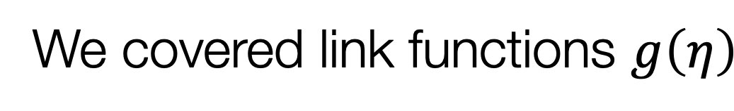
We covered link functions $g\left(η\right)$
Here are the most frequent examples which you will certainly encounter
Distribution of dependent variable | Exponential Family (Distribution) | Link Function | Suitable Model
Continuous measures | Normal distribution | Identity (we’ve been using this all this while) | Linear regression
Binary measures (1 = “present” or 0 = “absent”) | Bernoulli distribution | Logit | Logistic Regression
Binomial measure (or proportion) | Binomial distribution | Logit function on aggregated outcome for successful and failures | Logistic Regression
Counts or discrete measures | Poisson distribution | Log or ln | Poisson Regression
5
Notes:
Going to next page: How does one write the null and alternative hypothesis?

Slide 6
In terms of regression, there are several types of models, each with there own families depending on the type distribution for the dependent variable:
Here is a board overview:
Notes 1: Recall that we only touched on the fact the outcomes can measures that are from a different distribution, but we never really touched on this matter and on these particular classes of regression models
Distribution of dependent variable | Suitable Model
Continuous measures: e.g., average income in postcode (£); concentrations of ambient particular matter (PM2.5); Normalised Vegetative Difference Index (NDVI) etc., | Linear regression
Binary measures (1 = “present” or 0 = “absent”): e.g., Person’s voting for a candidate, Lung cancer risk, house infested with rodents etc., | Logistic Regression
Binomial measure (or proportion): e.g., prevalence of houses in a postcode infested with rodents, percentage of people in a village infected with intestinal parasitic worms, prevalence of household on a street segment victimised by crime etc., | Logistic Regression
Counts or discrete measures: e.g., number of reported burglaries on a street segment, number of riots in a county etc., | Poisson Regression
Time-to-event binary measures: e.g., Lung cancer risk due to chronic exposure to environmental levels of indoor radon. Risk of landslide and time dependence of surface erosion etc., | Survival Analysis with Cox regression
6
Notes:
…particularly for binary and discrete measures, and so this is where generalized linear regression modelling comes to play. [Turn to next slide]

Slide 7
What are Generalised Additive Models (GAMs)?
7

Slide 8
Definition:
Generalized additive model (GAMs) is a flexible generalization of any ordinary regression model, as well as it is a smoothing technique which allows the user to model non-linear relationships between an outcome y with a set of other independent variables x.
The typical statistical formulation of GAM:
$$y_{i}= α+f_{1}{(x}_{1,1})+f_{2}(x_{1,2})+…+f_{p}(x_{i,p})+ε$$
What are GAMs exactly (in plain English):
With linear models, we have explored to date are the considered as the “go-to” models. We have seen many adaptations (i.e., non-spatial and spatial) on a variety of conditions (i.e., Gaussian, Binomial and Poisson) and data types (i.e., continuous, binary or counts/rates).
GAMs are simply an adaptation of a Generalised Linear Model (GLM) that can deal with non-linear data while maintaining explainability.
8
Notes:
Just like GLMs, GAMs…

Slide 9
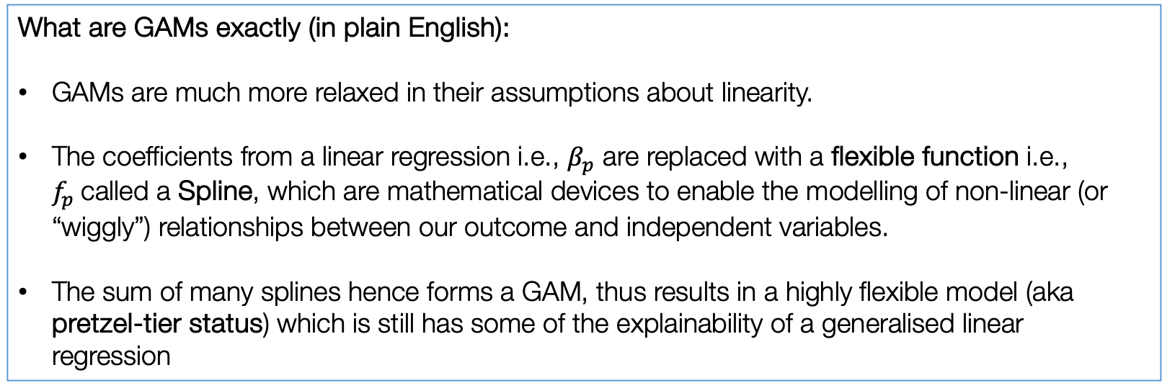
Re-formulation of a GLM to GAM:
Equation 1 is the formulation of a GLM:
$$y_{i}= β_{0}+β_{1}x_{1,1}+β_{2}x_{1,2}+…+β_{p}x_{i,p}+ε$$
Note 1: We should be familiar with this model now!
Equation 2 is the formulation of a GAM:
$$y_{i}= α+f_{1}{(x}_{1,1})+f_{2}(x_{1,2})+…+f_{p}(x_{i,p})+ε$$
What are GAMs exactly (in plain English):
GAMs are much more relaxed in their assumptions about linearity.
The coefficients from a linear regression i.e., $β_{p}$ are replaced with a flexible function i.e., $f_{p}$called a Spline, which are mathematical devices to enable the modelling of non-linear (or “wiggly”) relationships between our outcome and independent variables.
The sum of many splines hence forms a GAM, thus results in a highly flexible model (aka pretzel-tier status) which is still has some of the explainability of a generalised linear regression
Note 2: I will come to the maths in a second. As you will see, the flexible functions are something as simple as incorporating a quadratic, cubic and higher order functions into equation 2 as splines and making each variable a function.
Note 3: Interpretations are mostly through visual outputs
9
Notes:
Just like GLMs, GAMs…

Slide 10
Trade-offs between Flexibility and Interpretability
Note 1: You will be taught ML neural networks which use a lot of GAMs
GAM
Linear Models
Black-Box ML
Linear models are easy to interpret and to use for inference: It is easy to understand the meaning of their parameters. However, we often need to model more complex phenomena than can be represented by linear relationships.
On the other hand, machine learning models, like boosted regression trees or neural networks, can be very good at making predictions of complex relationships. The problem is that they tend to need lots of data, are quite difficult to interpret, and one can rarely make inferences from the model results.
GAMs offer a middle ground: they can be fit to complex, nonlinear relationships and make good predictions in these cases, but we are still able to do inferential statistics and understand and explain the underlying structure of our models and why they make predictions that they do.
Source: [GAMs in R by Noam Ross]
10
Notes:
Whenever we build statistical models, we face a trade-off between flexibility and interpretability. GAMs offer a middle ground between simple models, such as those we fit with linear regression, and more complex machine learning models like neural networks.

Slide 11
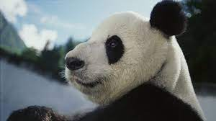
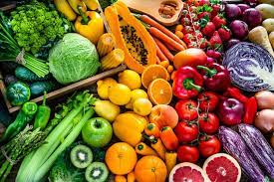


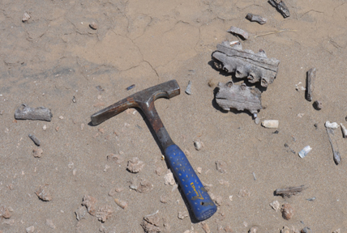
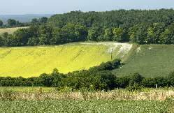
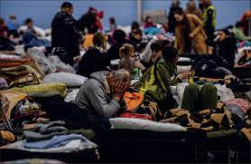
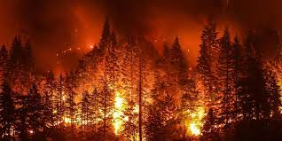
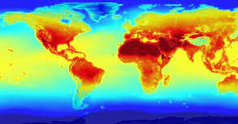
Zoology
Food security
Environmental Criminology
Environmental & Spatial Epidemiology
Vector-borne disease
Palaeontogy and Archology
Landscape ecology
Natural Disaster Science
Climate
Humanitarian crisis
11
Notes:
Application is quite massive in nearly all scientific domains and in other realms of research.

Slide 12
Model Components of a GAM
12
Notes:
https://noamross.github.io/gams-in-r-course/chapter2
https://www.youtube.com/watch?v=6V_VvweZkoI
https://towardsdatascience.com/generalised-additive-models-6dfbedf1350a
https://environmentalcomputing.net/statistics/gams/
https://rdrr.io/cran/dlnm/man/chicagoNMMAPS.html

Slide 13
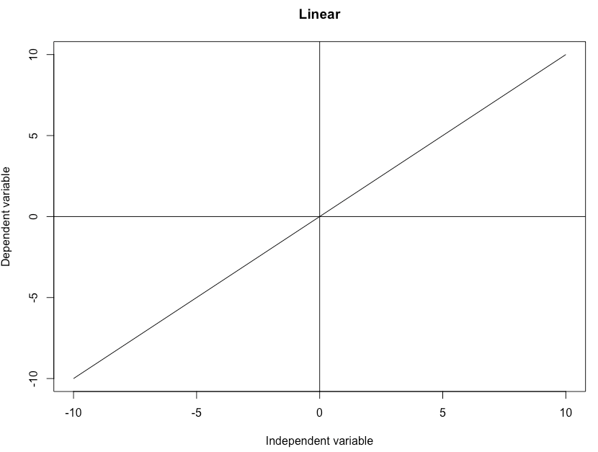
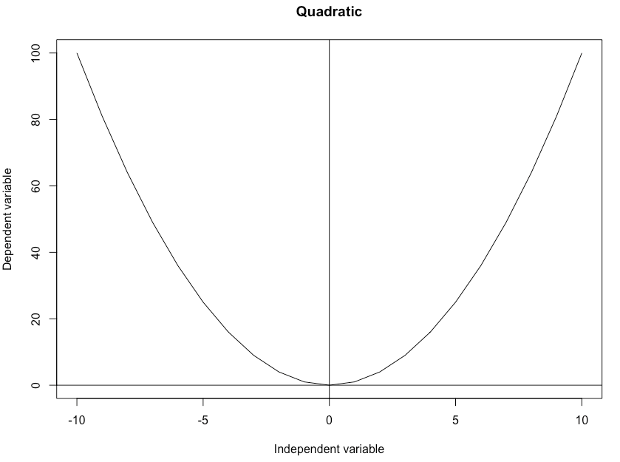
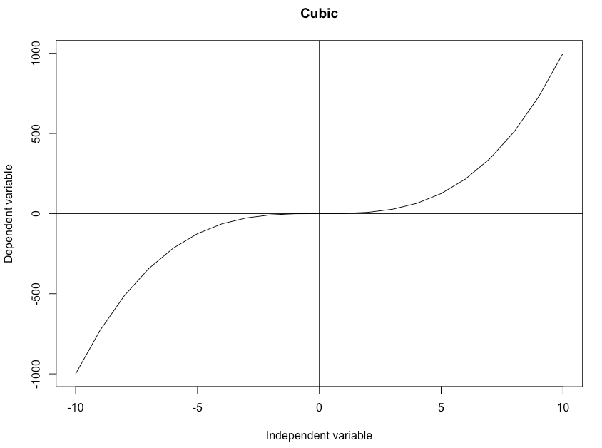



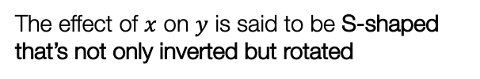
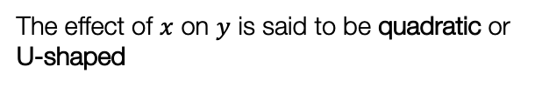

Maths 101: Polynomial functions [1]
Polynomial functions is a mathematical device – when an independent variable is expressed with some kind power. Usually, it should be a power that is of an integer with a non-negative value.
Linear (1), Quadratic (2), Cubic (3) and polynomial functions with a higher degree (i.e. powers with 4 and onwards)
Linear function: $y=x$
Quadratic function: $y=x^{2}$
Cubic function: $y=x^{3}$
The effect of $x$ on $y$ is said to be linear
The effect of $x$ on $y$ is said to be quadratic or U-shaped
The effect of $x$ on $y$ is said to be S-shaped that’s not only inverted but rotated
13
Notes:
Let us form the connection between the splines and basic polynomials

Slide 14
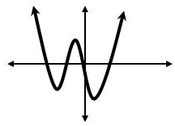
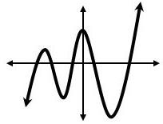
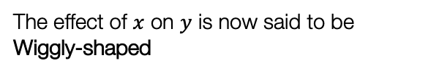



Maths 101: Polynomial functions [2]
Higher degree (with degree of 4): $y=x^{4}$
Higher degree (with degree of 5): $y=x^{5}$
The effect of $x$ on $y$ is said to be W-shaped
The effect of $x$ on $y$ is now said to be Wiggly-shaped
You may think to yourself why go through these classes of polynomials?
14

Slide 15
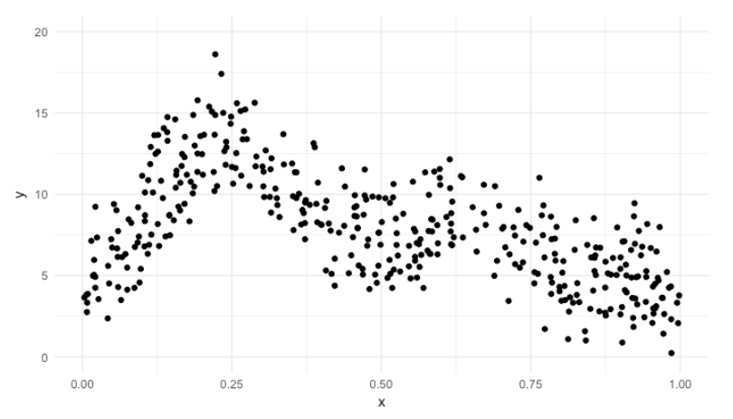
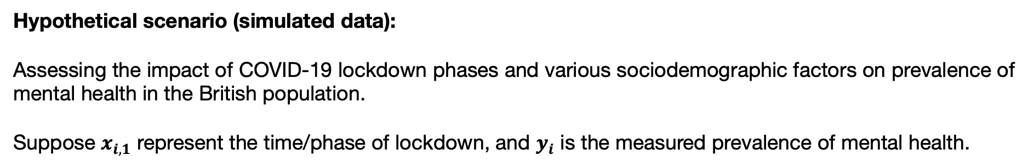
GLM versus GAM: which one to use? [1]
GAMs enable the user to fit a polynomial function on an independent variable in order for the model to fit the data nicely.
Hypothetical scenario (simulated data):
Assessing the impact of COVID-19 lockdown phases and various sociodemographic factors on prevalence of mental health in the British population.
Suppose $x_{i,1}$ represent the time/phase of lockdown, and $y_{i}$ is the measured prevalence of mental health.
What model should we pick?
Prevalence (%)
$$y_{i}= β_{0}+β_{1}x_{i,1}+β_{2}x_{i,2}+…+β_{p}x_{i,p}+ε$$
$$y_{i}= α+f_{1}{(x}_{i,1})+f_{2}(x_{i,2})+…+f_{p}(x_{i,p})+ε$$
COVID-19 Lockdown
15
Notes:
Here I've made a scatter plot of two variables, X and Y. We can see from the scatterplot that there is clearly some relationship between the variables, but it is not linear.

Slide 16
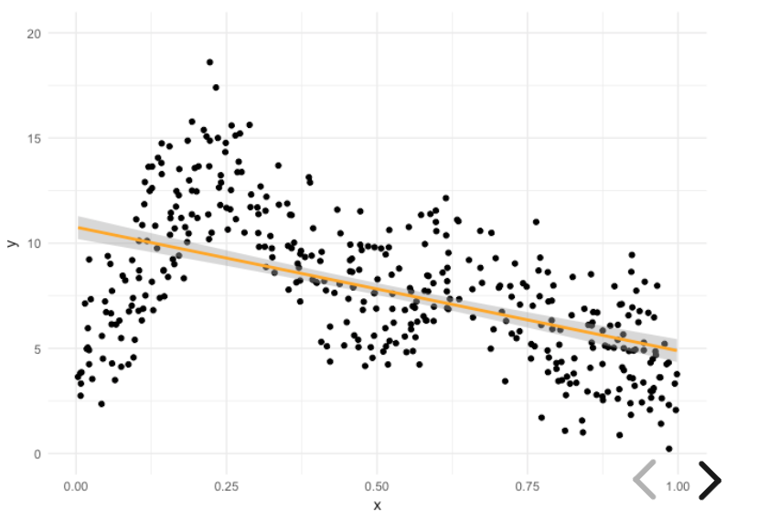
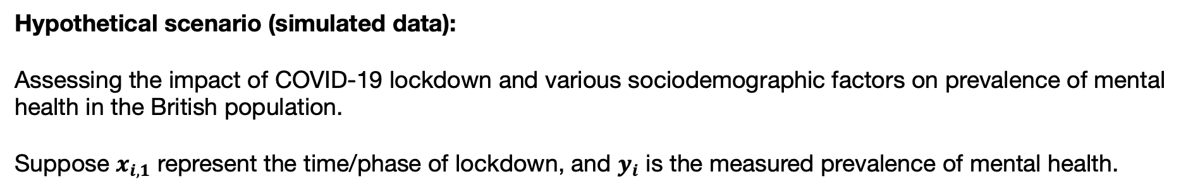
GLM versus GAM: which one to use? [2]
GAMs enable the user to fit a polynomial function on an independent variable in order for the model to fit the data nicely.
Hypothetical scenario (simulated data):
Assessing the impact of COVID-19 lockdown and various sociodemographic factors on prevalence of mental health in the British population.
Suppose $x_{i,1}$ represent the time/phase of lockdown, and $y_{i}$ is the measured prevalence of mental health.
Here, we have regressed $x_{i,1}$ using a linear function
Clearly the models does not capture key aspects of this relationship!
What model should we pick?
Prevalence (%)
$$y_{i}= β_{0}+β_{1}x_{i,1}+β_{2}x_{i,2}+…+β_{p}x_{i,p}+ε$$
$$y_{i}= α+f_{1}{(x}_{i,1})+f_{2}(x_{i,2})+…+f_{p}(x_{i,p})+ε$$
COVID-19 Lockdown
16
Notes:
If we fit a linear model to the data using the lm() function and the usual formula syntax, we can see it won't do a very good job. The model doesn't capture key aspects of this relationship.

Slide 17
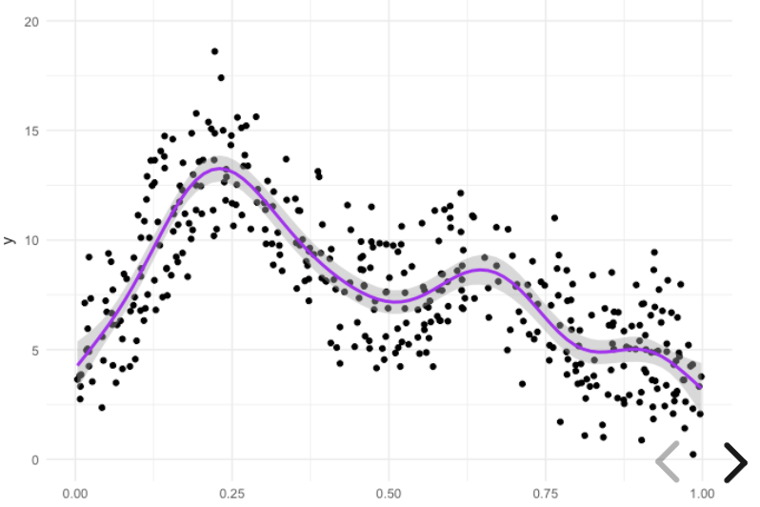
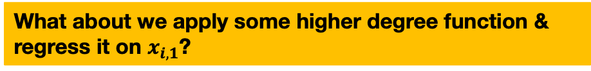
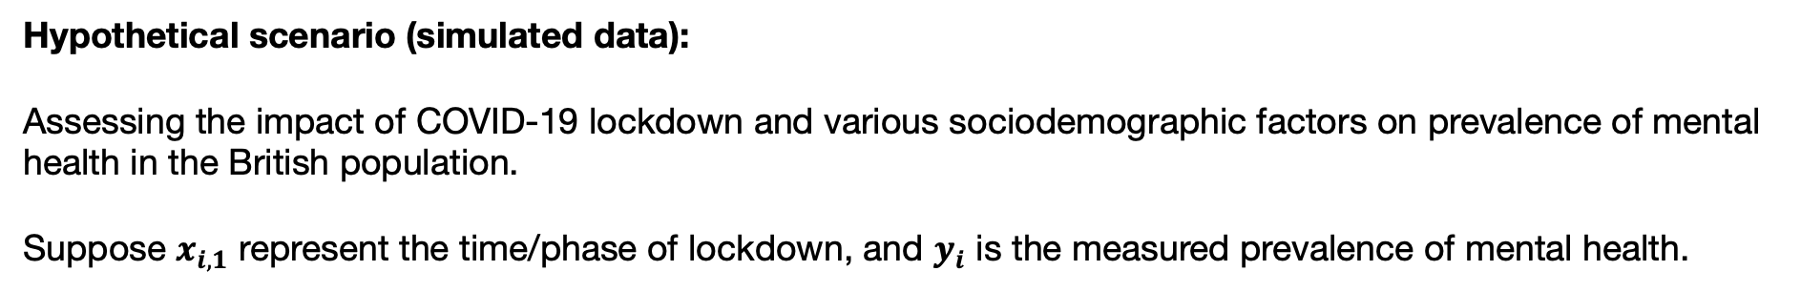
GLM versus GAM: which one to use? [3]
GAMs enable the user to fit a polynomial function on an independent variable in order for the model to fit the data nicely.
Hypothetical scenario (simulated data):
Assessing the impact of COVID-19 lockdown and various sociodemographic factors on prevalence of mental health in the British population.
Suppose $x_{i,1}$ represent the time/phase of lockdown, and $y_{i}$ is the measured prevalence of mental health.
What about we apply some higher degree function & regress it on $x_{i,1}$?
Clearly this model does capture key aspects of this relationship!
What model should we pick?
Prevalence (%)
$$y_{i}= β_{0}+β_{1}x_{i,1}+β_{2}x_{i,2}+…+β_{p}x_{i,p}+ε$$
$$y_{i}= α+f_{1}{(x}_{i,1})+f_{2}(x_{i,2})+…+f_{p}(x_{i,p})+ε$$
17
COVID-19 Lockdown
Notes:
With a GAM, however, we can fit data with smooths, or splines, which are functions that can take on a wide variety of shapes – that can be of a polynomial.
Here, when we fit this GAM, we wrap the independent variable, x, in the f(), that is smooth function, which could be of a higher degree, to specify that we want this relationship to be flexible.
A GAM can capture the nonlinear aspects of not only this relationship, but of many nonlinear relationships, because of the flexibility of these functions.

Slide 18
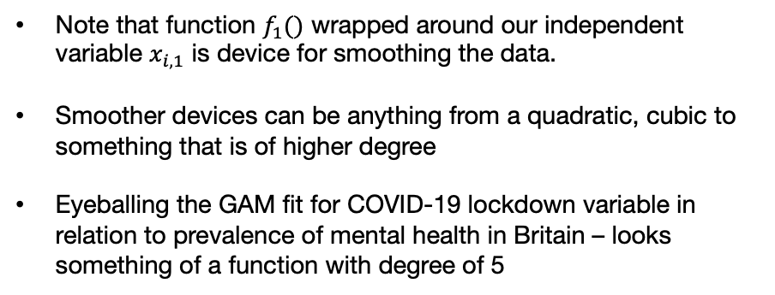
Smooth Spline
Note that function $f_{1}()$ wrapped around our independent variable $x_{i,1}$ is device for smoothing the data.
Smoother devices can be anything from a quadratic, cubic to something that is of higher degree
Eyeballing the GAM fit for COVID-19 lockdown variable in relation to prevalence of mental health in Britain – looks something of a function with degree of 5
$$y_{i}= α+f_{1}{(x}_{i,1})+f_{2}(x_{i,2})+…+f_{p}(x_{i,p})+ε$$
$$f_{1}{(x}_{i,1})={β_{5}x}_{i,1}^{5}+{β_{4}x}_{i,1}^{4}+{β_{3}x}_{i,1}^{3}+{β_{2}x}_{i,1}^{2}+β_{1}x_{i,1}$$
This is a known as a smooth spline, that allows for flexibility in the fitting. A series of Basis functions forms a GAM.
Higher degree (with degree of 5): $y=x^{5}$
Clearly this model does capture key aspects of this relationship!
Prevalence (%)
The effect of $x$ on $y$ is now said to be Wiggly-shaped
COVID-19 Lockdown
18

Slide 19
Basis function
Note that function $f_{1}()$ wrapped around our independent variable $x_{i,1}$ is device for smoothing the data.
Smoother devices can be anything from a quadratic, cubic to something that is of higher degree
Eyeballing the GAM fit for COVID-19 lockdown variable in relation to prevalence of mental health in Britain – looks something of a function with degree of 5
$$y_{i}= α+f_{1}{(x}_{i,1})+f_{2}(x_{i,2})+…+f_{p}(x_{i,p})+ε$$
$$f_{1}{(x}_{i,1})={β_{5}x}_{i,1}^{5}+{β_{4}x}_{i,1}^{4}+{β_{3}x}_{i,1}^{3}+{β_{2}x}_{i,1}^{2}+β_{1}x_{i,1}$$
The smoother/splines actually are constructed by many smaller functions, these are called Basis Functions. Note - each smooth is a sum of number of Basis functions, and each Basis function is multiplied by a coefficient such that each are a parameter in a model.
Higher degree (with degree of 5): $y=x^{5}$
Clearly this model does capture key aspects of this relationship!
Prevalence (%)
The effect of $x$ on $y$ is now said to be Wiggly-shaped
COVID-19 Lockdown
19
Notes:
The colour curves which are the basis are summed to formula the smooth curve!
What that being said – there are two output this a GAM generates – model prediction for forecast and coefficients which quantifies the association.
All outputs are graphed.

Slide 20
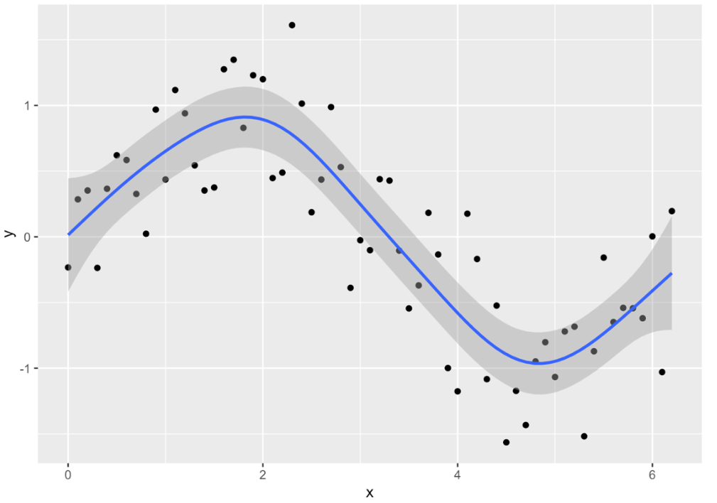
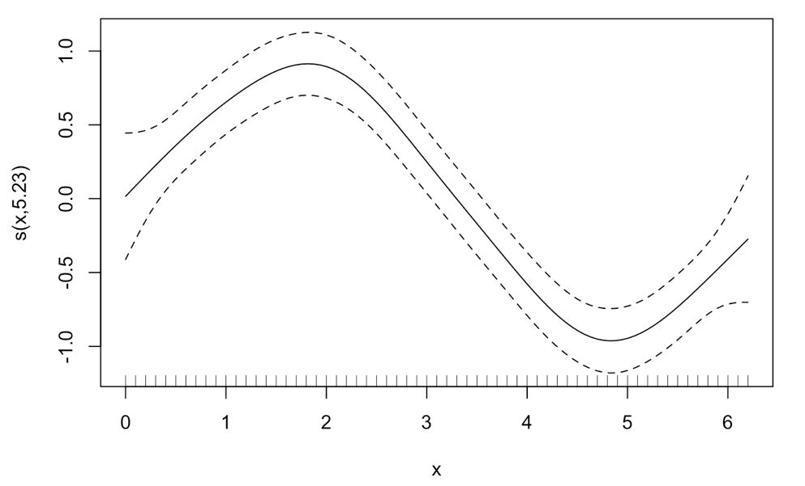

Outputs from the Basis function
A: Model fitting to data for Prediction & Forecast
B: Estimation of Parameter Coefficients
$β$ (w/ 95% CrI)
Predicted value for y based on x (w/ 95% CrI)
Independent variable x yields this effect ($β$) on y
Independent variable x yields something for y
For GAM, the dependent variables can come from a Gaussian, Binomial and/or Poisson distribution. Hence, you can specify the likelihood function accordingly. As for the independent variable – it can also take both continuous and categorical variables.
20

Slide 21
Example and Interpretation
21
Notes:
https://noamross.github.io/gams-in-r-course/chapter2
https://www.youtube.com/watch?v=6V_VvweZkoI
https://towardsdatascience.com/generalised-additive-models-6dfbedf1350a
https://environmentalcomputing.net/statistics/gams/
https://rdrr.io/cran/dlnm/man/chicagoNMMAPS.html

Slide 22
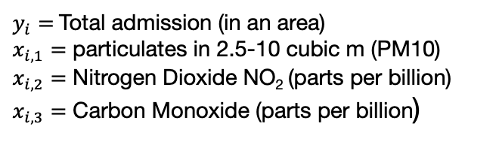
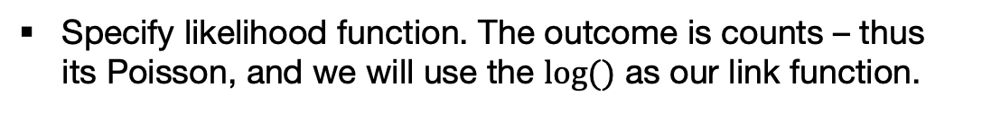
Example 1: Air quality and Respiratory admissions in Turin Province [1]
GOAL: Assessing the non-linear relationships between these three variables with hospitalisation in Turin.
Model formulation
Using a GAM with Basis function all variables
$$y_{t}= α+f_{1}{(x}_{i,1})+f_{2}{(x}_{i,2})+{f_{3}(x}_{i,3})+ε$$
$y_{i}=$ Total admission (in an area)
$x_{i,1}=$ particulates in 2.5-10 cubic m (PM10)
$x_{i,2}=$ Nitrogen Dioxide NO₂ (parts per billion)
$x_{i,3}=$ Carbon Monoxide (parts per billion)
Specify likelihood function. The outcome is counts – thus its Poisson, and we will use the $log⁡()$ as our link function.
$$y_{t }\sim Poisson\left(μ_{t}\right){: log(μ}_{t})= α+f_{1}{(x}_{i,1})+f_{2}{(x}_{i,2})+{f_{3}(x}_{i,3})$$
Build Bayesian model
Recall the Bayes’ Rule: $P\left(θ | Y\right)∝P\left(Y | θ\right)P(θ)$
$$P\left(β_{k}, τ | { log⁡(μ}_{t})\right)∝P\left({ log⁡(μ}_{t}) | β_{k}, τ\right) P\left(β_{k}\right) P(τ)$$
Let’s run the analysis in R using Bayesian Regression Modelling in Stan package (brms).
You may think this will be hard – but the next step is super easiest!
22

Slide 23
Example 1: Air quality and Mortality in Chicago (1987-2000) [2]
R Code from “brms”
>>> brms::stancode(model.bayes.gam) >>>
Translate to Stan code automatically
install.packages(“brms”)
library(“brms”)
# run a GAM model
model.bayes.gam <- brm(bf(Overall ~ s(PM10) + s(CO) + s(NO2)),
data = respiratory_data,
family = poisson(),
prior = prior.list,
cores = 6,
iter = 8000,
warmup = 1000,
thin = 10,
refresh = 0,
control = list(adapt_delta = 0.99))
// generated with brms 2.18.0
functions {
}
data {
int<lower=1> N; // total number of observations
int Y[N]; // response variable
// data for splines
int Ks; // number of linear effects
matrix[N, Ks] Xs; // design matrix for the linear effects
// data for spline s(PM10)
int nb_1; // number of bases
int knots_1[nb_1]; // number of knots
// basis function matrices
matrix[N, knots_1[1]] Zs_1_1;
// data for spline s(CO)
int nb_2; // number of bases
int knots_2[nb_2]; // number of knots
// basis function matrices
matrix[N, knots_2[1]] Zs_2_1;
// data for spline s(NO2)
int nb_3; // number of bases
int knots_3[nb_3]; // number of knots
// basis function matrices
matrix[N, knots_3[1]] Zs_3_1;
int prior_only; // should the likelihood be ignored?
}
transformed data {
}
parameters {
real Intercept; // temporary intercept for centered predictors
vector[Ks] bs; // spline coefficients
// parameters for spline s(PM10)
// standarized spline coefficients
vector[knots_1[1]] zs_1_1;
real<lower=0> sds_1_1; // standard deviations of spline coefficients
// parameters for spline s(CO)
// standarized spline coefficients
vector[knots_2[1]] zs_2_1;
real<lower=0> sds_2_1; // standard deviations of spline coefficients
// parameters for spline s(NO2)
// standarized spline coefficients
vector[knots_3[1]] zs_3_1;
real<lower=0> sds_3_1; // standard deviations of spline coefficients
}
transformed parameters {
// actual spline coefficients
vector[knots_1[1]] s_1_1;
// actual spline coefficients
vector[knots_2[1]] s_2_1;
// actual spline coefficients
vector[knots_3[1]] s_3_1;
real lprior = 0; // prior contributions to the log posterior
// compute actual spline coefficients
s_1_1 = sds_1_1 * zs_1_1;
// compute actual spline coefficients
s_2_1 = sds_2_1 * zs_2_1;
// compute actual spline coefficients
s_3_1 = sds_3_1 * zs_3_1;
lprior += student_t_lpdf(Intercept | 3, 3, 2.5);
lprior += student_t_lpdf(sds_1_1 | 3, 0, 2.5)
- 1 * student_t_lccdf(0 | 3, 0, 2.5);
lprior += student_t_lpdf(sds_2_1 | 3, 0, 2.5)
- 1 * student_t_lccdf(0 | 3, 0, 2.5);
lprior += student_t_lpdf(sds_3_1 | 3, 0, 2.5)
- 1 * student_t_lccdf(0 | 3, 0, 2.5);
}
model {
// likelihood including constants
if (!prior_only) {
// initialize linear predictor term
vector[N] mu = rep_vector(0.0, N);
mu += Intercept + Xs * bs + Zs_1_1 * s_1_1 + Zs_2_1 * s_2_1 + Zs_3_1 * s_3_1;
target += poisson_log_lpmf(Y | mu);
}
// priors including constants
target += lprior;
target += std_normal_lpdf(zs_1_1);
target += std_normal_lpdf(zs_2_1);
target += std_normal_lpdf(zs_3_1);
}
generated quantities {
// actual population-level intercept
real b_Intercept = Intercept;
}
This time around the coding is a lot easier. You can
use this as an alternative option to writing raw Stan
code.
23

Slide 24
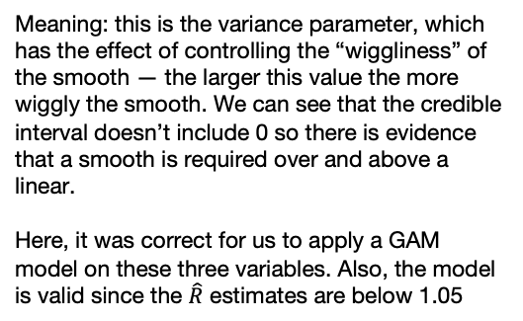
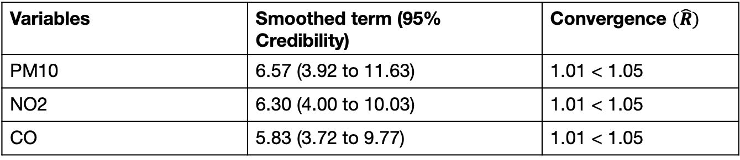
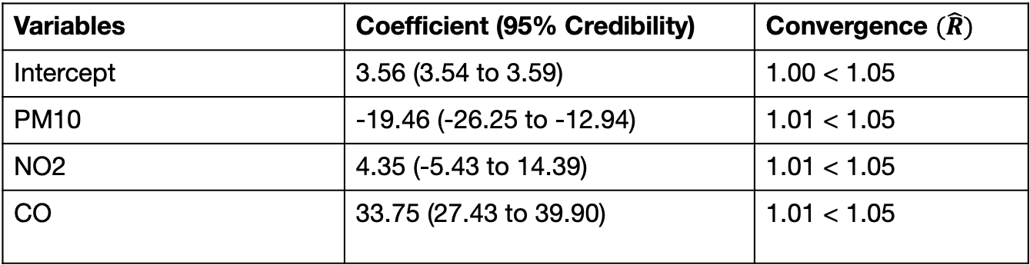
Example 1: Air quality and Mortality in Chicago (1987-2000) [2]
Smoothed terms
Variables | Smoothed term (95% Credibility) | Convergence $(\hat{R})$
PM10 | 6.57 (3.92 to 11.63) | 1.01 < 1.05
NO2 | 6.30 (4.00 to 10.03) | 1.01 < 1.05
CO | 5.83 (3.72 to 9.77) | 1.01 < 1.05
Meaning: this is the variance parameter, which has the effect of controlling the “wiggliness” of the smooth — the larger this value the more wiggly the smooth. We can see that the credible interval doesn’t include 0 so there is evidence that a smooth is required over and above a linear.
Here, it was correct for us to apply a GAM model on these three variables. Also, the model is valid since the $\hat{R}$ estimates are below 1.05
Population-level (Global) effect
Variables | Coefficient (95% Credibility) | Convergence $(\hat{R})$
Intercept | 3.56 (3.54 to 3.59) | 1.00 < 1.05
PM10 | -19.46 (-26.25 to -12.94) | 1.01 < 1.05
NO2 | 4.35 (-5.43 to 14.39) | 1.01 < 1.05
CO | 33.75 (27.43 to 39.90) | 1.01 < 1.05
Meaning: These are our global estimates which are considered as fixed effects. We will interpret these as we usually interpret a regression the usual way.
24

Slide 25
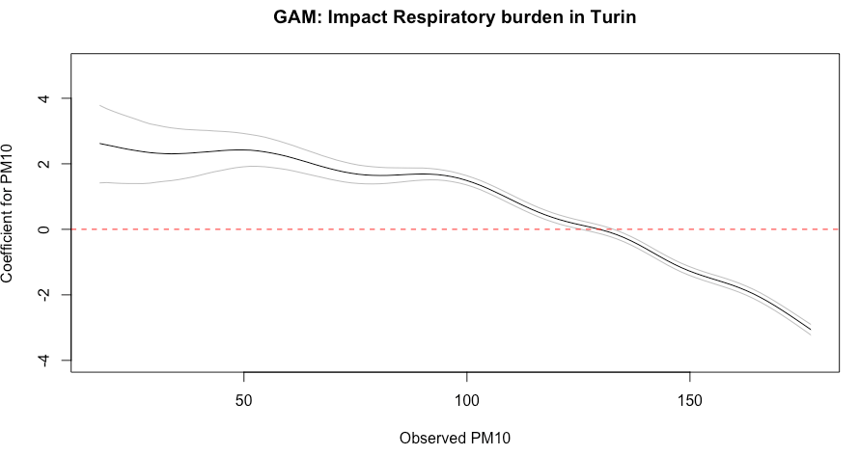
Population-level (Global) effect of
PM10: | -19.46 (-26.25 to -12.94)
Significant increase
Pattern: Overall decrease
Significant decrease
25

Slide 26
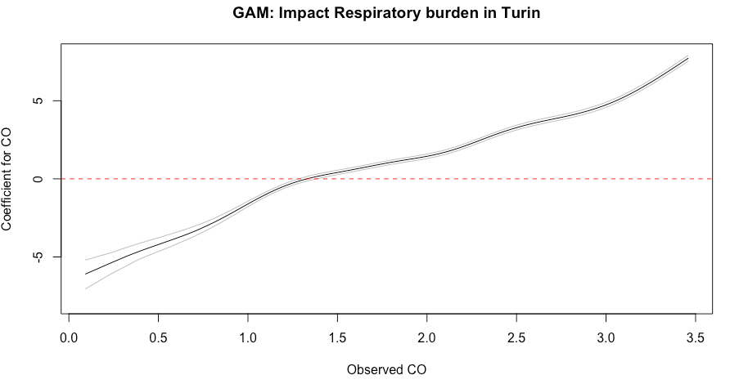
Population-level (Global) effect of
CO: | 33.75 (27.43 to 39.90)
Significant increase
Pattern: Overall increase
Significant decrease
26

Slide 27
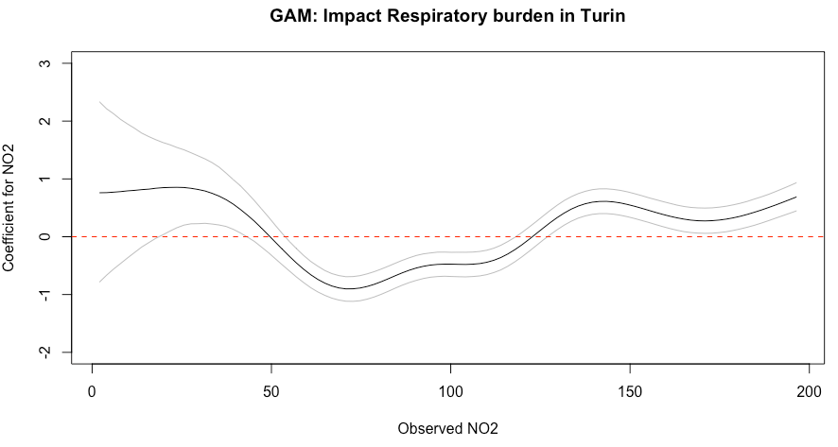
Population-level (Global) effect of
NO2: | 4.35 (-5.43 to 14.39)
Pattern: U-Shape and wiggly
Significant increase
Significant increase
Significant decrease
27

Slide 28
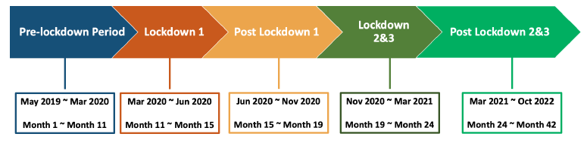
Example 2: COVID-19 lockdown phases and impact on crime resurgence in Nottingham (Antisocial Behaviour [ASB]) [1]
Understand the geospatial crime recovery patterns for the incidence of Antisocial Behaviour (ASB) events in-between the different lockdown phases in Nottingham across all 182 LSOAs.
To examine whether these ASB patterns were statistically significant. Hence a stratified Poisson GAM model was used for each LSOA.
Gehui Qi (2023) Investigating the Crime Recovery Patterns in Nottingham in the Post-Lockdown Period using Social Disorganisation Theory. UCL Undergraduate Dissertation 2022/23. Department of Geography. Submitted BA Geography with Social Data Sciences. Download: [Click]
Data Repository: https://github.com/qghuihuihui/Dissertation-2023
28

Slide 29
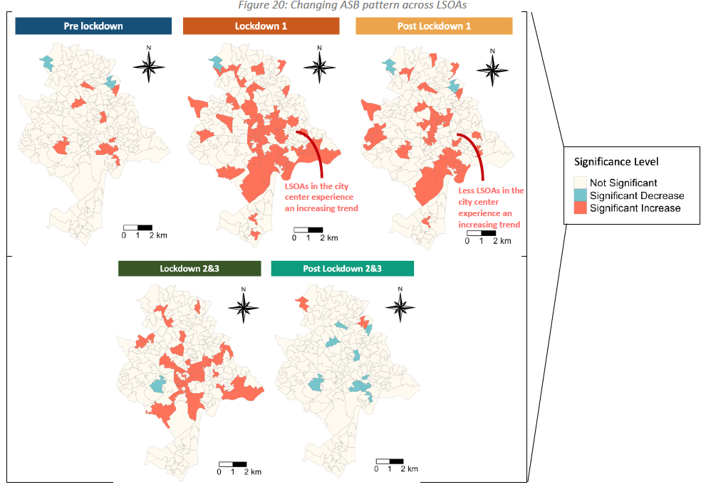
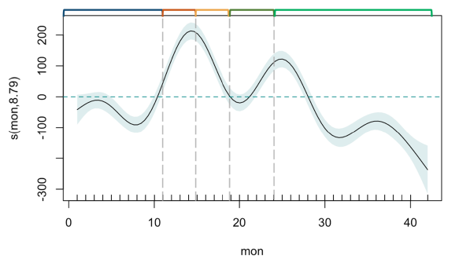
Example 2: COVID-19 lockdown phases and impact on crime resurgence in Nottingham (Antisocial Behaviour [ASB]) [2]
Change in incidence rate of ASB
Effect on COVID-19 Lockdown phase (Months)
A series of Poisson GAMs were implemented on each LSOAs. 182 GAM plots were generated for each LSOA which had patterns showing the effect of lockdown (months) on changes in incidences of ASB.
The phases for LSOAs were broadly classed either a significant ‘increase’, ‘decrease’ or not significant all in ASB during those periods. These were extracted and plotted on to the map of Nottingham for interpretation.
29

Slide 30
Any questions?
30

